Slide 1

Zoom Behavior Insight
Presented by:
Ofir Duek , Aviv Meir , Rotem Aloni

Slide 2
We generate synthetic images of students in Zoom classes to train a model that predicts a
4-dimensional vector of engagement statistics describing how focused the student appears

Slide 3
Problem & Use Case
The Problem:
In large Zoom classes, teachers cannot really track what each student is doing on their screen.
Impact:
It is hard to know who is actively engaged and who is distracted.
Our idea:
Automatically extract per-student behavior statistics from each Zoom frame.
Example:
For each student we output:
P(looking at the camera)
P(external / noisy background)
P(wearing headphones)
P(holding an object, e.g., a phone)

Slide 4
ML Task & Output Definition
Task: Multi-label image classification of student behavior in Zoom frames.
Input – Single 400x400 RGB webcam image of one student in a Zoom class
Output - 4 behavior scores, each between 0% and 100%:
Camera gaze
External / noisy background
Headphones
Object in hand

Slide 5
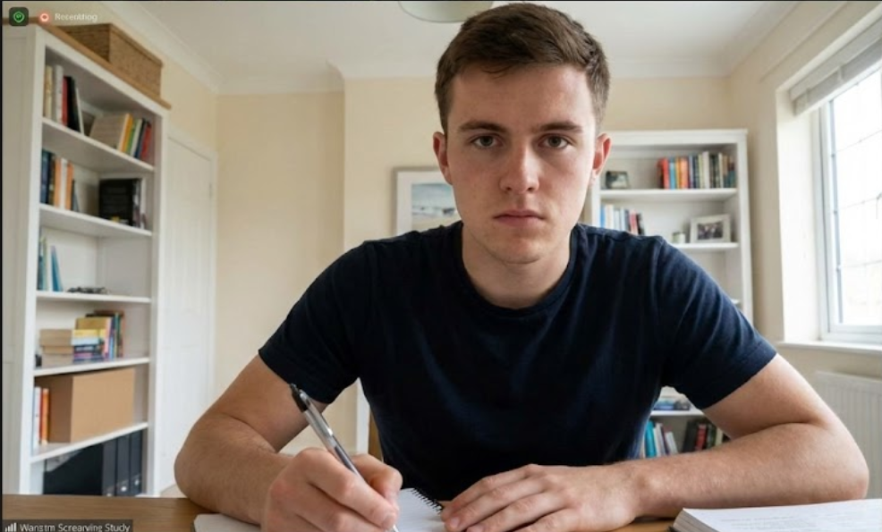
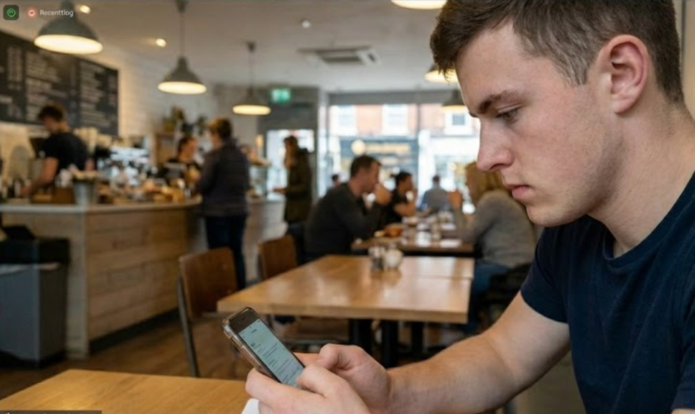
Example 1: Student looking at the
screen/camera, in a quiet room, writing notes.
Example output:
Camera gaze: ~90%
External / noisy background: ~10%
Headphones: ~0%
Object in hand: ~20%
Example 2: Student looking down at a phone,
slightly turned away from the screen.
Example output:
Camera gaze: ~10%
External / noisy background: ~80%
Headphones: ~20%
Object in hand: ~95% (phone)

Slide 6
Dataset Overview
Data Sources:
Real webcam-like images of students sitting in front of a laptop.
Synthetic images generated with Stable Diffusion + inpainting using prompts that control camera gaze, background, headphones, and object in hand.
Annotations (Labels):
For each image we define 4 binary labels:
  Camera gaze (1 = looking at the camera, 0 = not)
  External / noisy background (1 = yes, 0 = no)
  Headphones (1 = wearing, 0 = not)
  Object in hand (1 = holding an object, 0 = not)
Labels are stored in a CSV/JSON file together
with the image filename.
During training, the model learns to predict a
0%-100% score for each label.
Data Split
Train 80%, validation 10%, test 10%.
Test set will use only real images to measure performance on real data.
Size & Format
Target: ~1000-2000 images in total.
RGB, 400x400 JPG/PNG files.

Slide 7
Synthetic Data Generation Pipeline
Choose a target behavior configuration
(e.g., looking at the camera, quiet background, no headphones, no object in hand).
Generate a base “student at laptop” image with Stable Diffusion.
Use inpainting to edit specific regions and control:
– Camera gaze (towards the camera vs. looking down / to the side)
– Background (quiet room vs. busy café / street)
– Headphones (add / remove)
– Object in hand (add / remove phone, pen or notebook)
Save the final synthetic image together with its 4 binary labels.

Slide 8
Behavior Control & Prompt Examples
What we control in the synthetic images:
Camera gaze - looking at the laptop screen / looking at a phone / looking sideways.
Background - quiet study room vs. busy café or street.
Headphones - wearing headphones vs. no headphones.
Object in hand - holding a phone, pen or notebook vs. hands on keyboard or table.
Examples:
Looking at the laptop screen, quiet room, no headphones, and no object in hands.
Prompt example - Student sitting at a desk, looking at laptop screen, quiet study room, no phone and no headphones.
Looking down at a phone, busy café, with headphones and a phone in the hand.
Prompt example – Student in a busy café, looking down at a smartphone, wearing headphones, people in the background.

Slide 9
Model & Training Setup
We plan to use a pretrained convolutional neural network (CNN) and adapt it to predict 4 behavior scores for each student image.
Model:
Pretrained CNN backbone (e.g., ResNet-18)
Replace the final classification layer with 4 output units, one score for each behavior (camera gaze, external background, headphones, object in hand).
Apply a sigmoid activation to get 0%-100% scores per output.
Training setup:
Input preprocessing
  Resize each image to 400x400 RGB.
  Normalize pixel values.
  Simple data augmentation (random horizontal flip, small brightness/contrast changes).
Loss & optimizer
  Loss - binary cross-entropy over the 4 labels.
  Optimizer - Adam with a small learning rate.
Training modes
  Baseline – freeze the CNN backbone, train only the last 4-output layer.
  Fine-tuned model – also train the last CNN layers together with the final layer.

Slide 10
Experiments & Metrics
We define how to measure performance and which experiments we plan to run
Metrics
We will evaluate the model using:
Accuracy per behavior (camera gaze, external background, headphones, object in hand).
Macro F1-score averaged over the 4 behaviors.
Calibration analysis - check how predicted scores (0%-100%) match the true 0/1 labels on the real test set.
Evaluation procedure
Planned experiments
Baseline vs. fine-tuned CNN:
Same train/validation data (real + synthetic)
  Model 1 - backbone frozen, train only the last 4-output layer.
  Model 2 - fine-tune the last CNN layers and the final layer.
Real-only vs. real + synthetic data:
Same fine-tuned architecture
  Train once on real images only.
  Train once on real + synthetic images
  Evaluate both models on the same real-image test set.
Convert each behavior score into 0/1 using a fixed threshold (e.g., 50%)
Compute accuracy and F1 for each behavior separately and then average over all 4 behaviors.
Report all final numbers on the real-image test set only.

Slide 11
Novelty & Contribution
Behavior-based representation of Zoom webcam images
Each student image is mapped to four behavior scores instead of a single label.
Synthetic Zoom-like dataset with controllable behaviors
We use Stable Diffusion and inpainting to generate and edit student images in a controlled way.
Systematic evaluation of model and data setups
We compare baseline vs fine-tuned CNNs and real-only vs real + synthetic training to see what works best on real webcam images.

Slide 12
Risks, Limitations & Next Steps
Risks & limitations:
Ambiguous images where behaviors are hard to label (unclear gaze, partially visible objects).
Synthetic images may not perfectly match real Zoom webcam frames.
Limited size and diversity of the real-image dataset.
Next steps:
Finalize data collection and labeling guidelines for the four behaviors.
Train the baseline and fine-tuned CNN models.
Run the experiments and analyze behavior-score quality on the real test set.

